Slide 1
Objectives
Define systems modeling and differentiate logical and physical models.
Define process modeling and explain its benefits.
Recognize and understand basic concepts and constructs of a process model.
Read and interpret a data flow diagram.
Explain when to construct process models and where to store them.
Construct a context diagram to illustrate a system’s interfaces with its environment.
Identify use cases, external and temporal business events.
Perform event partitioning and organize events in a functional decomposition diagram.
Draw event diagrams and merge them into a system diagram.
Draw primitive data flow diagrams and describe the elementary data flows in terms of data structures and procedural logic.
Document the distribution of processes to locations.
Synchronize data and process models using a CRUD matrix.

Slide 2
Models: Logical and Physical
Model – a pictorial representation of reality.
  Just as a picture is worth a thousand words, most models are pictorial representations of reality.
Logical model – a nontechnical pictorial representation that depicts what a system is or does. Synonyms or essential model, conceptual model, and business model.
Physical model – a technical pictorial representation that depicts what a system is or does and how the system is implemented. Synonyms are implementation model and technical model.
9-<number>

Slide 3
Why Logical System Models
Logical models remove biases that are the result of the way the system is currently implemented, or the way that any one person thinks the system might be implemented.
Logical models reduce the risk of missing business requirements because we are too preoccupied with technical results.
Logical models allow us to communicate with end-users in nontechnical or less technical languages.
9-<number>

Slide 4
Process Modeling and DFDs
Process modeling – a technique used to organize and document a system’s processes.
  Flow of data through processes
  Logic
  Policies
  Procedures
Data flow diagram (DFD) – a process model used to depict the flow of data through a system and the work or processing performed by the system. Synonyms are bubble chart, transformation graph, and process model.
  The DFD has also become a popular tool for business process redesign.
9-<number>

Slide 5
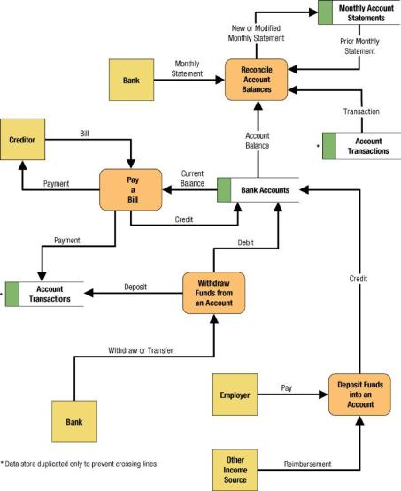
Simple Data Flow Diagram
9-<number>

Slide 6
Differences Between DFDs and Flowcharts
Processes on DFDs can operate in parallel (at-the-same-time)
  Processes on flowcharts execute one at a time
DFDs show the flow of data through a system
  Flowcharts show the flow of control (sequence and transfer of control)
Processes on a DFD can have dramatically different timing (daily, weekly, on demand)
  Processes on flowcharts are part of a single program with consistent timing
9-<number>

Slide 7


External Agents
External agent – an outside person, unit, system, or organization that interacts with a system. Also called an external entity.
  External agents define the “boundary” or
  scope of a system being modeled.
  As scope changes, external agents can
  become processes, and vice versa.
  Almost always one of the following:
    Office, department, division.
    An external organization or agency.
    Another business or another
    information system.
    One of system’s end-users or managers
  Named with descriptive, singular noun
Gane and Sarson shape
DeMarco/Yourdon shape
9-<number>

Slide 8


Data Stores
Data store – stored data intended for later use. Synonyms are file and database.
  Frequently implemented as a file or database.
  A data store is “data at rest” compared to a data flow that is “data in motion.”
  Almost always one of the following:
    Persons (or groups of persons)
    Places
    Objects
    Events (about which data is captured)
    Concepts (about which data is important)
  Data stores depicted on a DFD store
  all instances of data entities
  (depicted on an ERD)
  Named with plural noun
Gane and Sarson shape
9-<number>
DeMarco/Yourdon shape

Slide 9
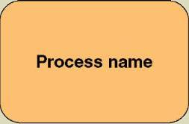
Process Concepts
Process – work performed by a system in response to incoming data flows or conditions. A synonym is transform.
  All information systems include
  processes - usually many of them
  Processes respond to business
  events and conditions and transform
  data into useful information
  Modeling processes helps us to understand the interactions with the system's environment, other systems, and other processes.
  Named with a strong action verb followed by object clause describing what the work is performed on/for .
Gane and Sarson shape
9-<number>

Slide 10
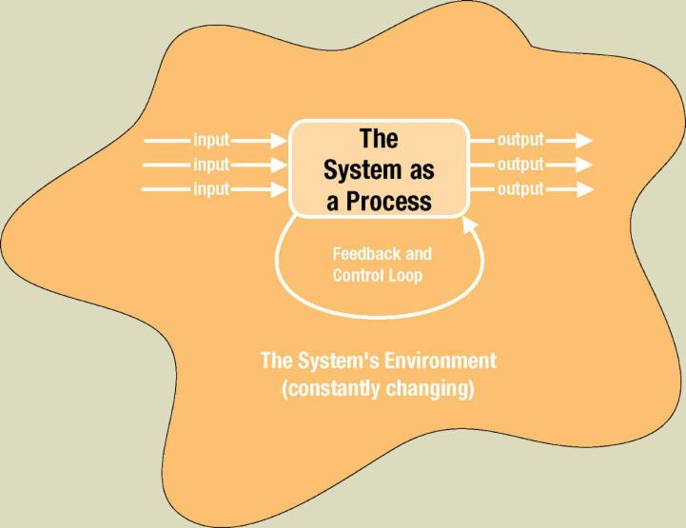
The System is Itself a Process
9-<number>

Slide 11
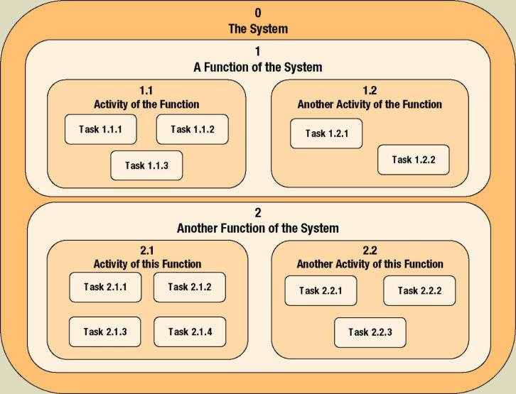
Process Decomposition
Decomposition – the act of breaking a system into sub-components. Each level of abstraction reveals more or less detail.
9-<number>

Slide 12
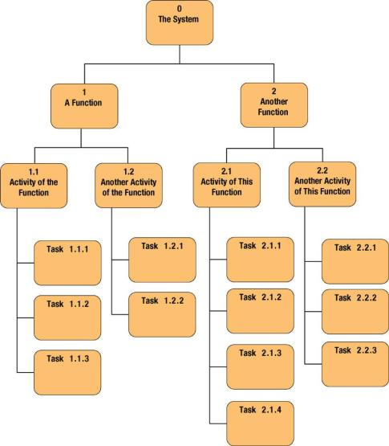
Decomposition Diagrams
Decomposition diagram – a tool used to depict the decomposition of a system. Also called hierarchy chart.
9-<number>

Slide 13
Types of Logical Processes
Function – a set of related and ongoing activities of a business.
  A function has no start or end.
Event – a logical unit of work that must be completed as a whole. Sometimes called a transaction.
  Triggered by a discrete input and is completed when process has responded with appropriate outputs.
  Functions consist of processes that respond to events.
Elementary process – a discrete, detailed activity or task required to complete the response to an event. Also called a primitive process.
  The lowest level of detail depicted in a process model.
9-<number>

Slide 14
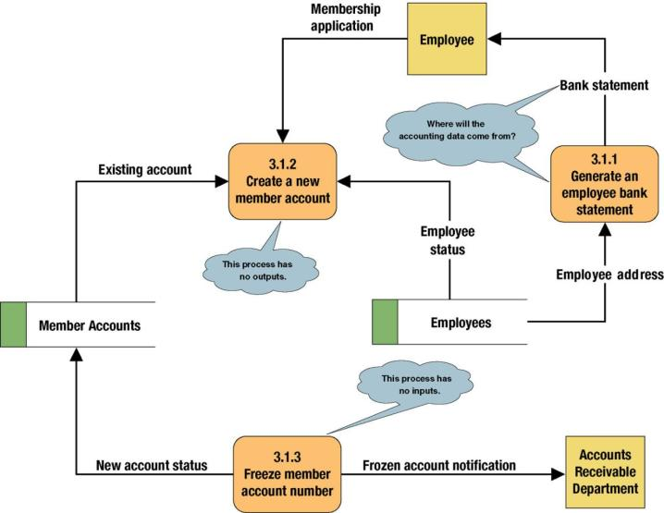
Common Process Errors on DFDs
9-<number>

Slide 15
Data Flows & Control Flows
Data flow – data that is input to or output from a process.
  A data flow is data in motion
  A data flow may also be used to represent the creation, reading, deletion, or updating of data in a file or database (called a data store).
Composite data flow – a data flow that consists of other data flows.
Control flow – a condition or nondata event that triggers a process.
  Used sparingly on DFDs.
Data flow name
Control flow name
9-<number>

Slide 16
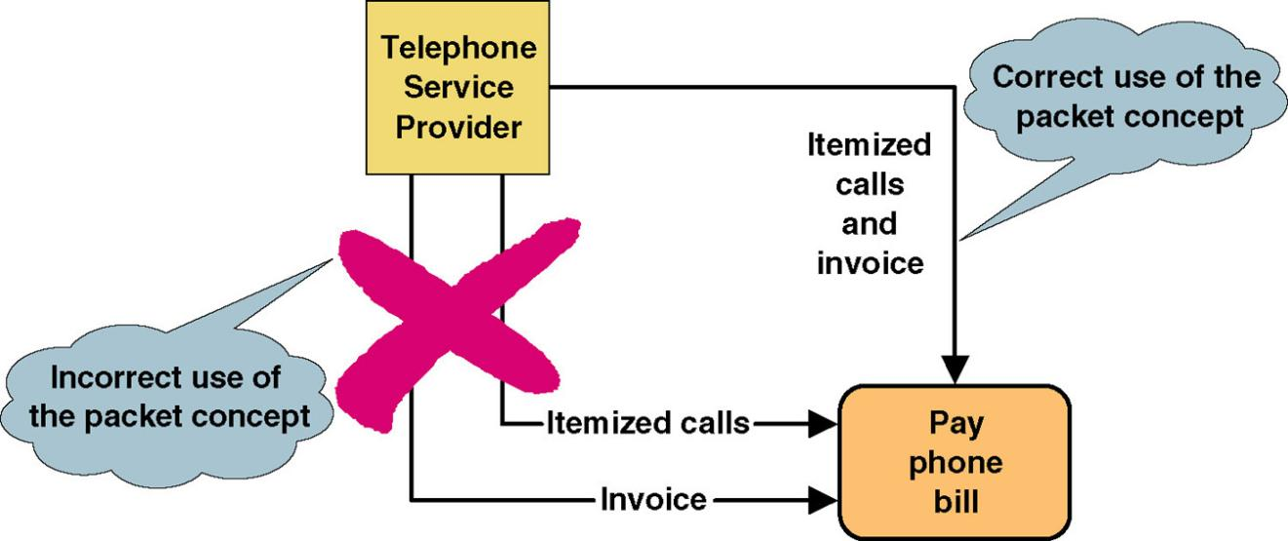
Data Flow Packet Concept
Data that should travel together should be shown as a single data flow, no matter how many physical documents might be included.
9-<number>

Slide 17
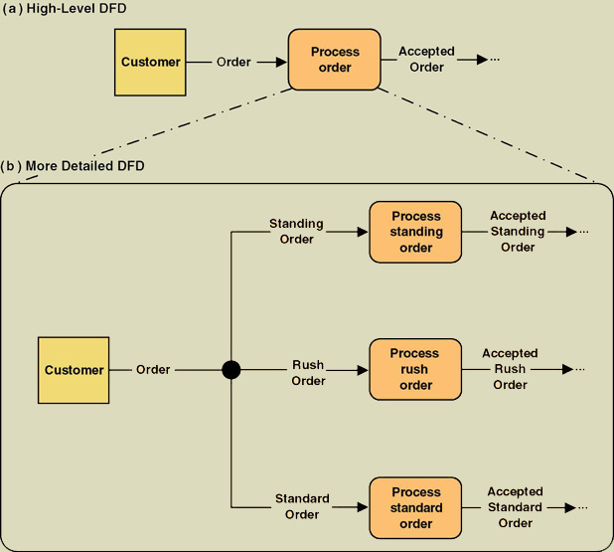
Composite and Elementary
Data Flows
Composite flow
Elementary flows
Junction indicates that any given order is an instance of only one of the order types.
9-<number>

Slide 18
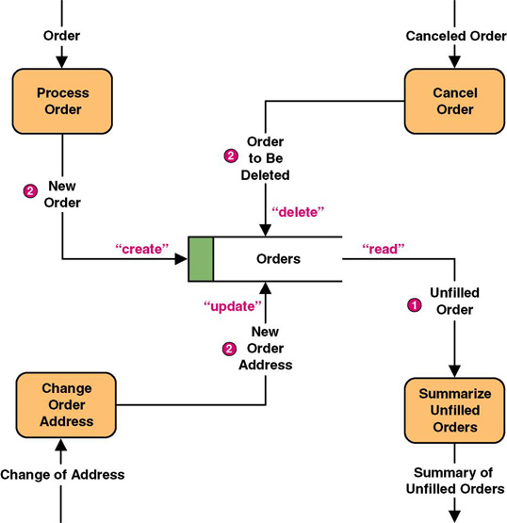
Data Flows to and from Data Stores
9-<number>

Slide 19
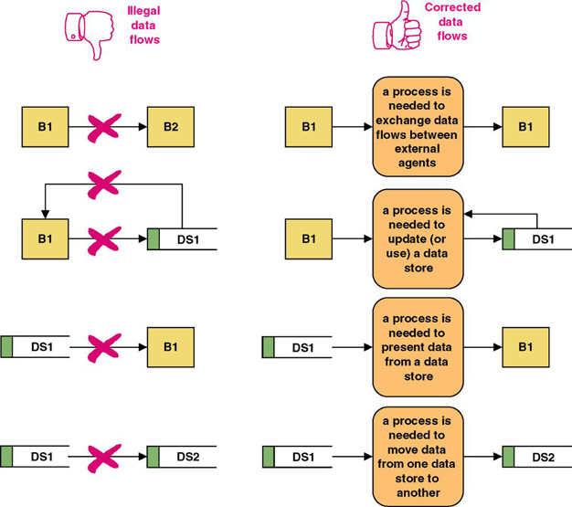
Rules for Data Flows
A data flow should never go unnamed.
In logical modeling, data flow names should describe the data flow without describing the implementation
All data flows must begin and/or end at a process.
9-<number>

Slide 20
Data Conservation
Data conservation – the practice of ensuring that a data flow contains only data needed by the receiving process.
  Sometimes called starving the processes.
  New emphasis on business process redesign to identify and eliminate inefficiencies.
  Simplifies the interface between those processes.
  Must precisely define the data composition of each data flow, expressed in the form of data structures.
9-<number>

Slide 21
Data Structures
Data attribute – the smallest piece of data that has meaning to the users and the business.
Data structure – a specific arrangement of data attributes that defines an instance of a data flow.
The data attributes that comprise a data flow are organized into data structures.
Data flows can be described in terms of the following types of data structures:
  A sequence or group of data attributes that occur one after another.
  The selection of one or more attributes from a set of attributes.
  The repetition of one or more attributes.
9-<number>

Slide 22
Data Structure for a Data Flow
DATA STRUCTURE
ORDER=
ORDER NUMBER +
ORDER DATE+
[ PERSONAL CUSTOMER NUMBER,
CORPORATE ACCOUNT NUMBER]+
SHIPPING ADDRESS=ADDRESS+
(BILLING ADDRESS=ADDRESS)+
1 {PRODUCT NUMBER+
PRODUCT DESCRIPTION+
QUANTITY ORDERED+
PRODUCT PRICE+
PRODUCT PRICE SOURCE+
EXTENDED PRICE } N+
SUM OF EXTENDED PRICES+
PREPAID AMOUNT+
(CREDIT CARD NUMBER+EXPIRATION DATE)
(QUOTE NUMBER)
ADDRESS=
(POST OFFICE BOX NUMBER)+
STREET ADDRESS+
CITY+
[STATE, MUNICIPALITY]+
(COUNTRY)+
POSTAL CODE
ENGLISH ENTERPRETATION
An instance of ORDER consists of:
ORDER NUMBER and
ORDER DATE and
Either PERSONAL CUSTOMER NUMBER
or CORPORATE ACCOUNT NUMBER
and SHIPPING ADDRESS (which is equivalent to ADDRESS)
and optionally: BILLING ADDRESS (which is equivalent to ADDRESS)
and one or more instances of:
PRODUCT NUMBER and
PRODUCT DESCRIPTION and
QUANTITY ORDERED and
PRODUCT PRICE and
PRODUCT PRICE SOURCE and
EXTENDED PRICE
and SUM OF EXTENDED PRICES and
PREPAID AMOUNT and
optionally: both CREDIT CARD NUMBER and EXPIRATION DATE
An instance of ADDRESS consists of:
optionally: POST OFFICE BOX NUMBER and
STREET ADDRESS and
CITY and
Either STATE or MUNICIPALITY
and optionally: COUNTRY
and POSTAL CODE
9-<number>

Slide 23
Data Structure Constructs
Data Structure | Format by Example (relevant portion is boldfaced | English Interpretation (relevant portion is boldfaced)
Sequence of Attributes - The sequence data structure indicates one or more attributes that may (or must) be included in a data flow. | WAGE AND TAX STATEMENT= TAXPAYER IDENTIFICATION NUMBER+ TAXPAYER NAME+ TAXPAYER ADDRESS+ WAGES, TIPS, AND COMPENSATION+ FEDERAL TAX WITHHELD+… | An instance of WAGE AND TAX STATEMENTS consists of: TAXPAYER IDENTIFICATION NUMBER and TAXPAYER NAME and TAXPAYER ADDRESS and WAGES, TIPS AND COMPENSATION and FEDERAL TAX WITHHELD and…
Selection of Attributes - The selection data structure allows you to show situations where different sets of attributes describe different instances of the data flow. | ORDER= (PERSONAL CUSTOMER NUMBER, CORPORATE ACCOUNT NUMBER)+ ORDER DATE+… | An instance or ORDER consists of: Either PERSONAL CUSTOMER NUMBER or CORPORATE ACCOUNT NUMBER; and ORDER DATE and…
9-<number>

Slide 24
Data Structure Constructs (continued)
Data Structure | Format by Example (relevant portion is boldfaced | English Interpretation (relevant portion is boldfaced)
Repetition of Attributes - The repetition data structure is used to set off a data attribute or group of data attributes that may (or must) repeat themselves a specific number of time for a single instance of the data flow. The minimum number of repetitions is usually zero or one. The maximum number of repetitions may be specified as “n” meaning “many” where the actual number of instances varies for each instance of the data flow. | POLICY NUMBER+ POLICYHOLDER NAME+ POLICY HOLDER ADDRESS+ 0 {DEPENDENT NAME+ DEPENDENT’S RELATIONSHIP} N+ 1 {EXPENSE DESCRIPTION+ SERVICE PROVIDER+ EXPENSE AMOUNT} N | An instance of CLAIM consists of: POLICY NUMBER and POLICYHOLDER NAME and POLICYHOLDER ADDRESS and zero or more instance of: DEPENDENT NAME and DEPENDENT’S RELATIONSHIP and one or more instances of: EXPENSE DESCRIPTION and SERVICE PROVIDER and EXPENSE ACCOUNT
9-<number>

Slide 25
Data Structure Constructs (concluded)
Data Structure | Format by Example (relevant portion is boldfaced | English Interpretation (relevant portion is boldfaced)
Optional Attributes - The optional notation indicates that an attribute, or group of attributes in a sequence or selection date structure may not be included in all instances of a data flow. Note: For the repetition data structure, a minimum of “zero” is the same as making the entire repeating group “optional.” | CLAIM= POLICY NUMBER+ POLICYHOLDER NAME+ POLICYHOLDER ADDRESS+ ( SPOUSE NAME+ DATE OF BIRTH)+… | An instance of CLAIM consists of: POLICY NUMBER and POLICYHOLDER NAME and POLICYHOLDER ADDRESS and optionally, SPOUSE NAME and DATE OF BIRTH and…
Reusable Attributes - For groups of attributes that are contained in many data flows, it is desirable to create a separate data structure that can be reused in other data structures. | DATE= MONTH+ DAY+ YEAR+ | Then, the reusable structures can be included in other data flow structures as follows: ORDER=ORDER NUMBER…+DATE INVOICE=INVOICE NUMBER…+DATE PAYMENT=CUSTOMER NUMBER…+DATE
9-<number>

Slide 26
Data Types and Domains
Data attributes should be defined by data types and domains.
Data type - a class of data that be stored in an attribute.
  Character, integers, real numbers, dates, pictures, etc.
Domain – the legitimate values for an attribute.
9-<number>

Slide 27
Diverging and Converging
Data Flows
Diverging data flow – a data flow that splits into multiple data flows.
  Indicates data that starts out naturally as one flow, but is routed to different destinations.
  Also useful to indicate multiple copies of the same output going to different destinations.
Converging data flow – the merger of multiple data flows into a single packet.
  Indicates data from multiple sources that can (must) come together as a single packet for subsequent processing.
9-<number>

Slide 28
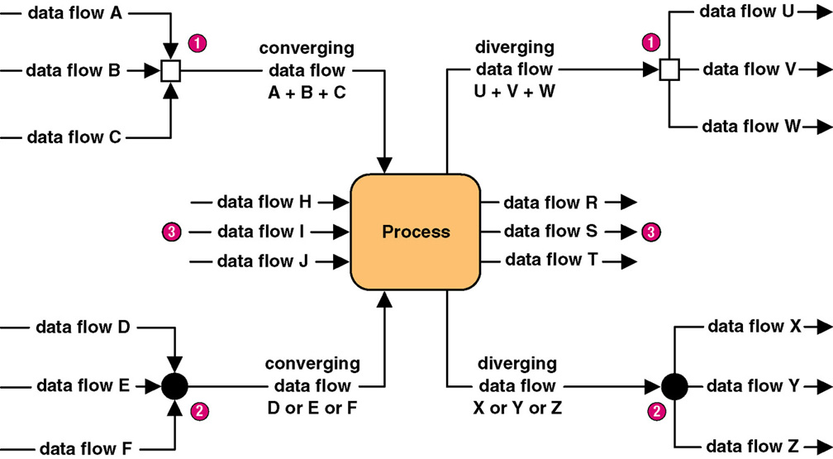
Diverging and Converging
Data Flows
9-<number>

Slide 29
When to Draw Process Models
Strategic systems planning
  Enterprise process models illustrate important business functions.
Business process redesign
  “As is” process models facilitate critical analysis.
  “To be” process models facilitate improvement.
Systems analysis (primary focus of this course)
  Model existing system including its limitations
  Model target system’s logical requirements
  Model candidate technical solutions
  Model the target technical solution
9-<number>

Slide 30
Classical Structured Analysis
Rarely practiced anymore because cumbersome & time-consuming
Draw top-down physical DFDs that represent current physical implementation of the system.
Convert physical DFDs to logical equivalents.
Draw top-down logical DFDs that represent improved system.
Describe all data flows, data stores, policies, and procedures in data dictionary or encyclopedia.
Optionally, mark up copies of the logical DFDs to represent alternative physical solutions.
Draw top-down physical DFDs representing target solution.
9-<number>

Slide 31
Modern Structured Analysis
(More Commonly Practiced)
Draw context DFD to establish initial project scope.
Draw functional decomposition diagram to partition the system into subsystems.
Create event-response or use-case list for the system to define events for which the system must have a response.
Draw an event DFD (or event handler) for each event.
Merge event DFDs into a system diagram (or, for larger systems, subsystem diagrams).
Draw detailed, primitive DFDs for the more complex event handlers.
Document data flows and processes in data dictionary.
9-<number>

Slide 32
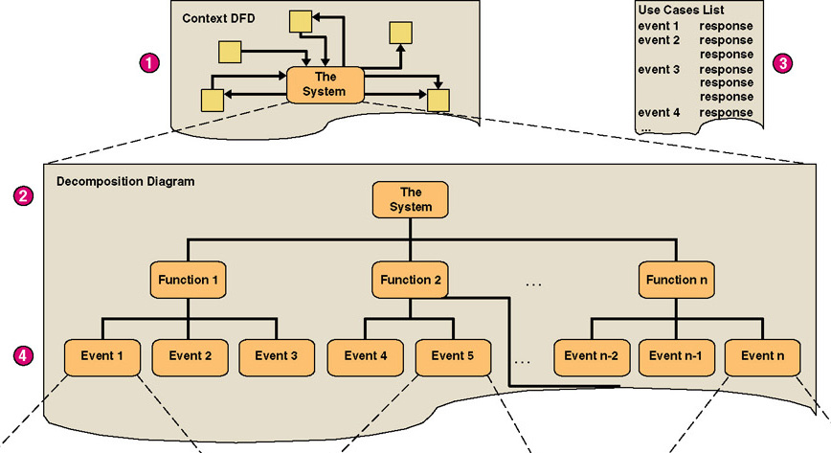
Structured Analysis Diagram Progression (1 of 3)
9-<number>

Slide 33
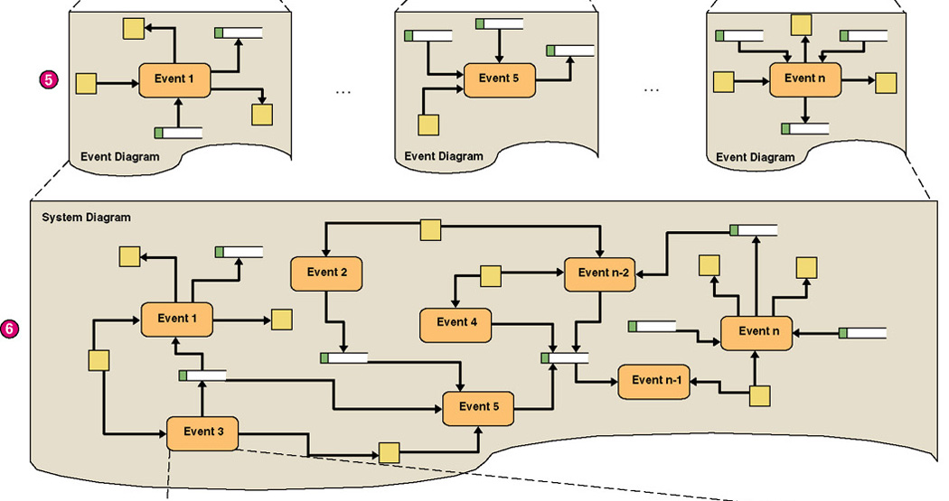
Structured Analysis Diagram Progression (2 of 3)
9-<number>

Slide 34
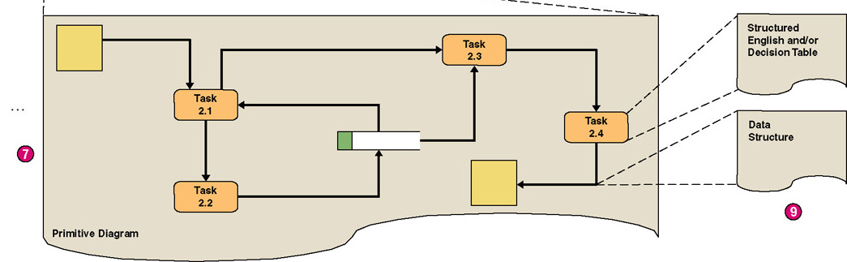
Structured Analysis Diagram Progression (3 of 3)
9-<number>

Slide 35
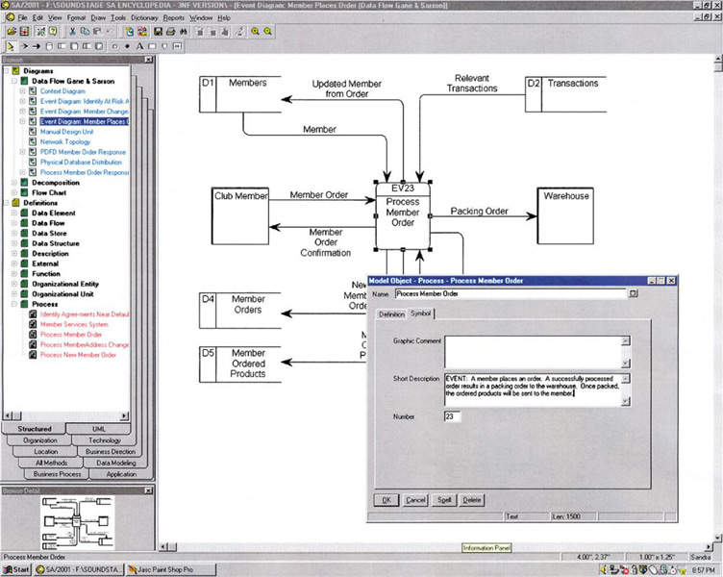
CASE for Process Modeling
9-<number>

Slide 36
Context Data Flow Diagram
Context data flow diagram - a process model used to document the scope for a system. Also called the environmental model.
  Think of the system as a "black box."
  Ask users what business transactions the system must respond to. These are inputs, and the sources are external agents.
  Ask users what responses must be produced by the system. These are outputs, and the destinations are external agents.
  Identify any external data stores, if any.
  Draw a context diagram.
9-<number>

Slide 37
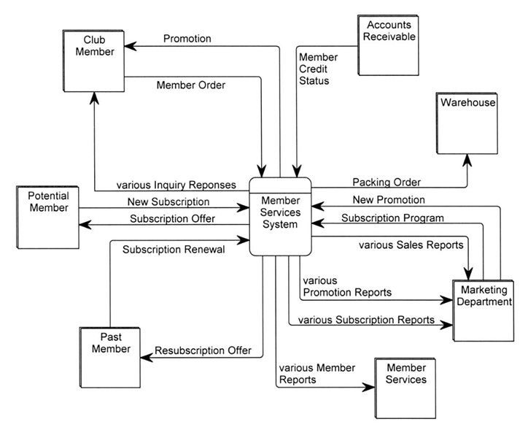
SoundStage Context DFD
9-<number>

Slide 38
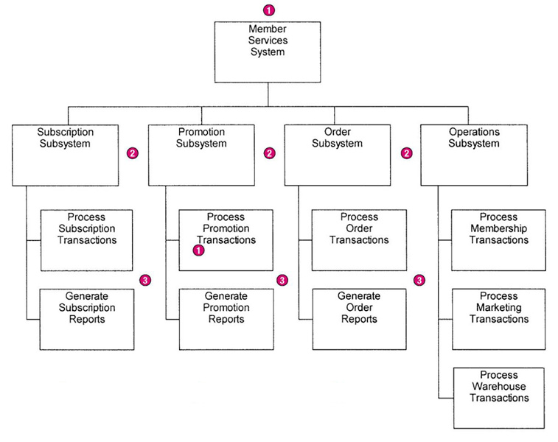
SoundStage Functional
Decomposition Diagram
Break system into sub-components to reveal more detail.
Every process to be factored should be factored into at least two child processes.
Larger systems might be factored into subsystems and functions.
9-<number>

Slide 39
Events and Use Cases
External events are initiated by external agents. They result in an input transaction or data flow.
Temporal events are triggered on the basis of time, or something that merely happens. They are indicated by a control flow.
State events trigger processes based on a system’s change from one state or condition to another. They are indicated by a control flow.
Use case – an analysis tool for finding and identifying business events and responses.
Actor – anything that interacts with a system.
9-<number>

Slide 40
SoundStage Partial Use Case List
Actor/ External Agent | Event (or Use Case) | Trigger | Response
Marketing | Establishes a new membership subscription plan to entice new members. | New Member Subscription Program | Generate Subscription Plan Confirmation. Create Agreement in the database.
Marketing | Establishes a new membership resubscription plan to lure back former members. | Past Member Resubscription Program | Generate Subscription Plan Confirmation. Create Agreement in the database.
(time) | A subscription plan expires. | (current date) | Generate Agreement Change Confirmation. Logically delete Agreement in database.
Member | Joins club by subscribing. | New Subscription | Generate Member Directory Update Confirmation. Create Member in database. Create first Member Order and Member Ordered Products in database.
9-<number>

Slide 41
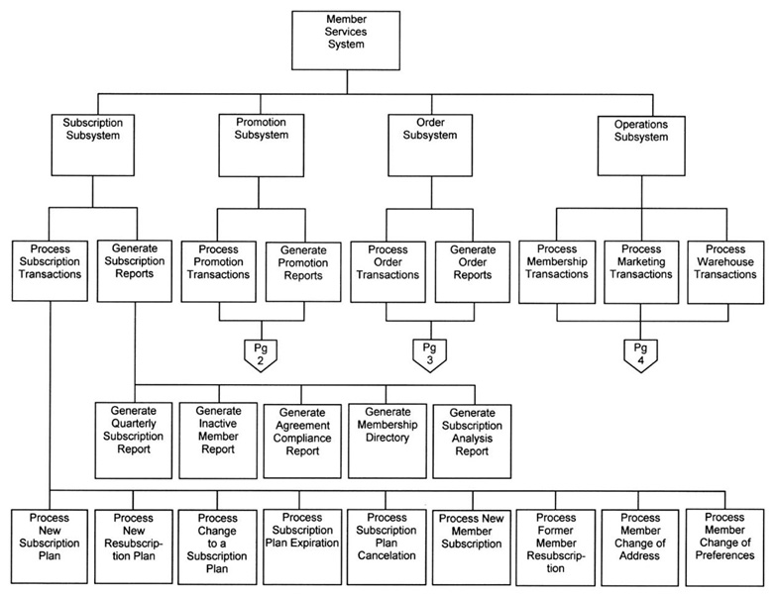
SoundStage Partial
Event Decomposition Diagram
9-<number>

Slide 42
Event Diagrams
Event diagram – data flow diagram that depicts the context for a single event.
  One diagram for each event process
  Depicts
    Inputs from external agents
    Outputs to external agents
    Data stores from which records must be "read." Data flows should be added and named to reflect the data that is read.
    Data stores in which records must be created, deleted, or updated. Data flows should be named to reflect the update.
9-<number>

Slide 43
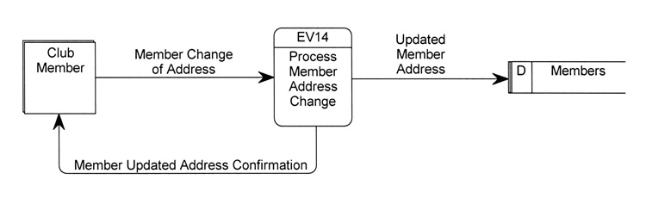
Simple Event Diagram
9-<number>

Slide 44
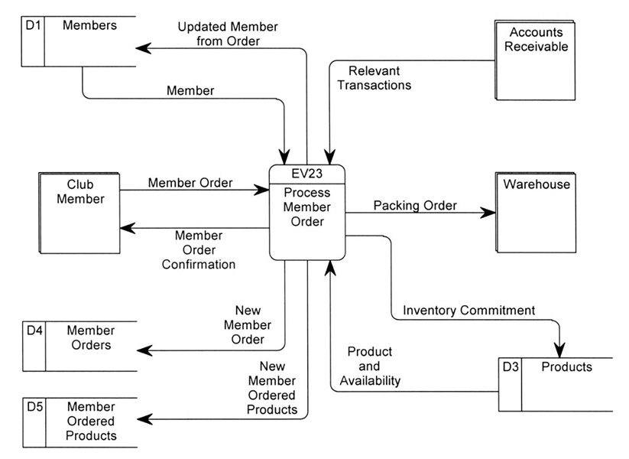
Event Diagram (more complex)
9-<number>

Slide 45
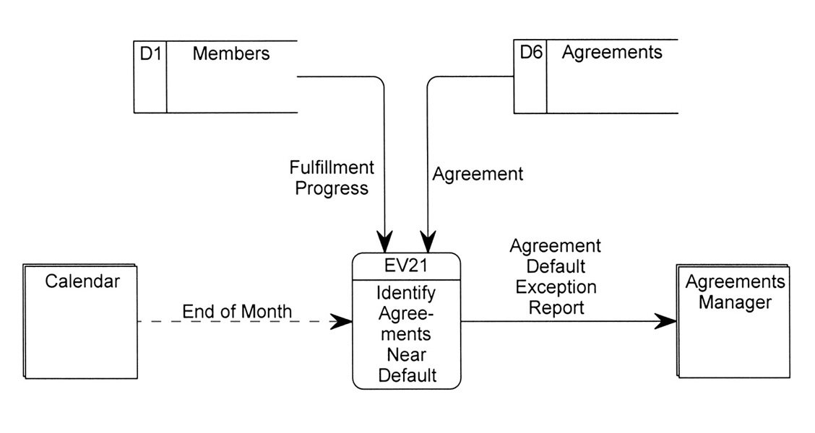
Temporal Event Diagram
9-<number>

Slide 46
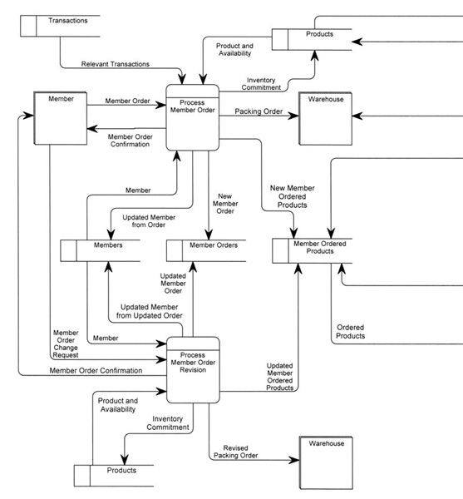
System DFD
9-<number>

Slide 47
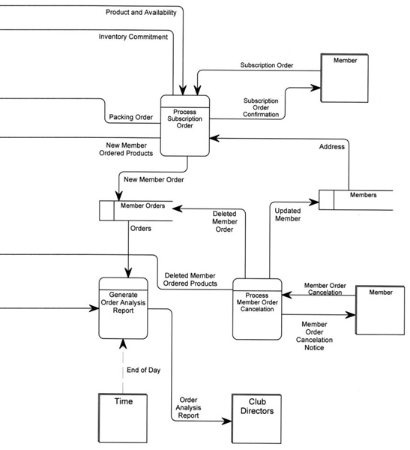
System DFD (concluded)
9-<number>

Slide 48
Balancing
Balancing - a concept that requires that data flow diagrams at different levels of detail reflect consistency and completeness
  Quality assurance technique
  Requires that if you explode a process to another DFD to reveal more detail, you must include the same dta flows and data stores
9-<number>

Slide 49
Primitive Diagrams
Some (not necessarily all) event processes may be exploded into primitive diagrams to reveal more detail.
  Complex business transaction processes
  Process decomposed into multiple elementary processes
  Each elementary process is cohesive - it does only one thing
  Flow similar to computer program structure
9-<number>

Slide 50
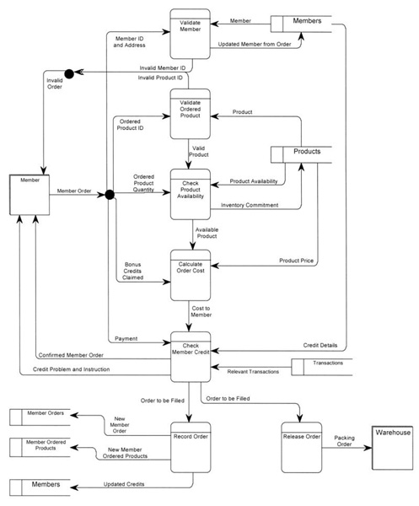
Primitive DFD
(see book for more readable copy)
9-<number>

Slide 51
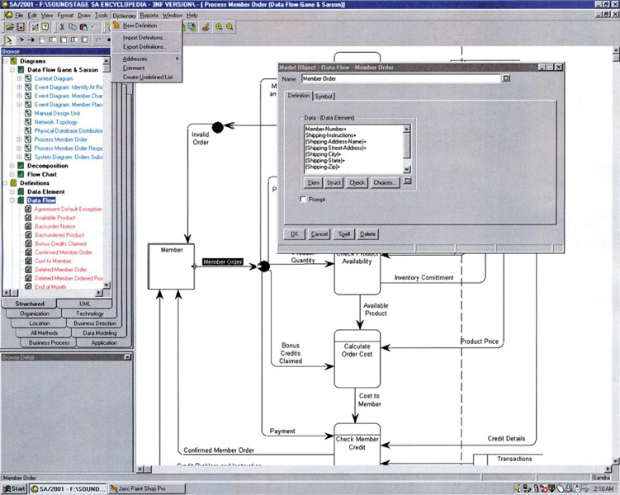
Specifying a Data Flow
Using a CASE Tool
9-<number>

Slide 52
Process Logic
Data Flow Diagrams good for identifying and describing processes
Not good at showing logic inside processes
Need to specify detailed instructions for elementary processes
How to do it?
  Flowcharts & Pseudocode - most end users do not understand them
  Natural English - imprecise and subject to interpretation
9-<number>

Slide 53
Problems with Natural English
Many do not write well and do not question writing abilities.
Many too educated to communicate with general audience
Some write everything like it was a program.
Can allow computing jargon, acronyms to dominate language.
Statements frequently have excessive or confusing scope.
Overuse compound sentences.
Too many words have multiple definitions.
Too many statements use imprecise adjectives.
Conditional instructions can be imprecise.
Compound conditions tend to show up in natural English.
9-<number>
Source: Adapted from Matthies, Leslie, The New Playscript Procedure, (Stamford, CT: Office Publications, Inc. 1977)

Slide 54
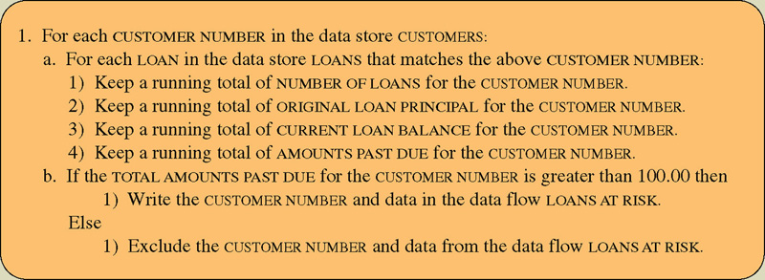
Structured English
Structured English – a language syntax for specifying the logic of a process.
  Based on the relative strengths of structured programming and natural English.
9-<number>

Slide 55
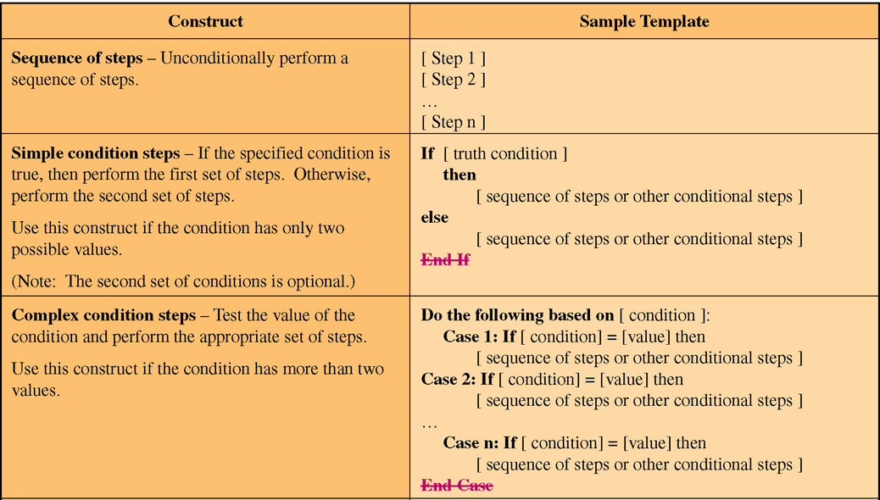
Structured English Constructs
(Part 1)
9-<number>

Slide 56
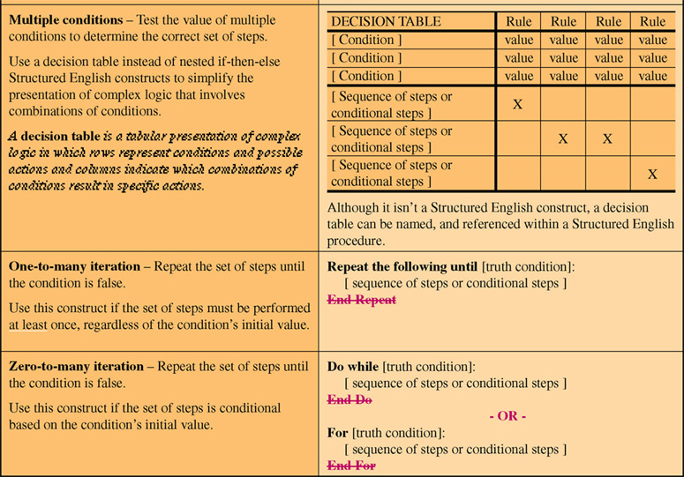
Structured English Constructs
(Part 2)
9-<number>

Slide 57
Structured English Restrictions on Process Logic
Only strong, imperative verbs may be used.
Only names that have been defined in project dictionary may be used.
Formulas should be stated clearly using appropriate mathematical notations.
Undefined adjectives and adverbs are not permitted.
Blocking and indentation are used to set off the beginning and ending of constructs.
User readability should always take priority.
9-<number>

Slide 58
Policies and Decision Tables
Policy – a set of rules that govern show a process is to be completed.
Decision table – a tabular form of presentation that specifies a set of conditions and their corresponding actions.
  As required to implement a policy.
9-<number>

Slide 59
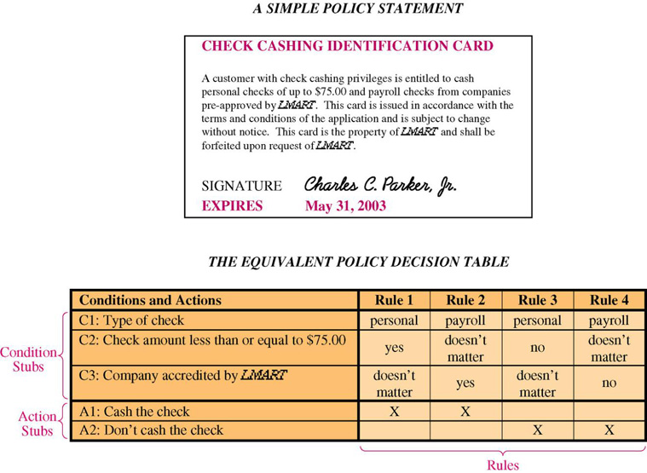
A Simple Decision Table
9-<number>

Slide 60
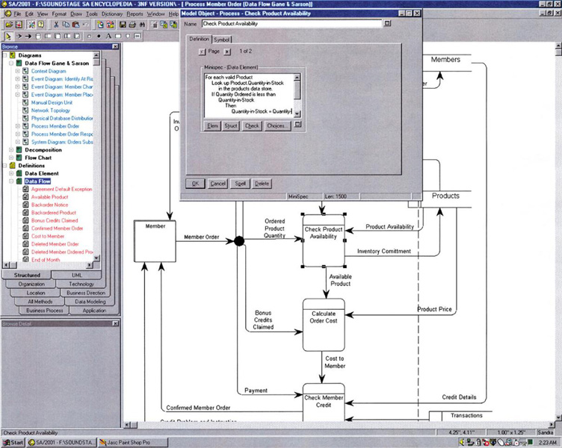
Describing an Elementary Process Using a CASE Tool
9-<number>

Slide 61
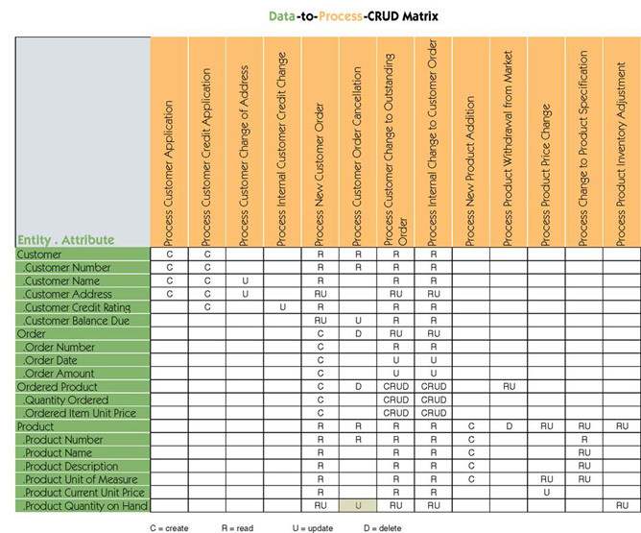
Data & Process Model Synchronization CRUD Matrix
9-<number>

Slide 62
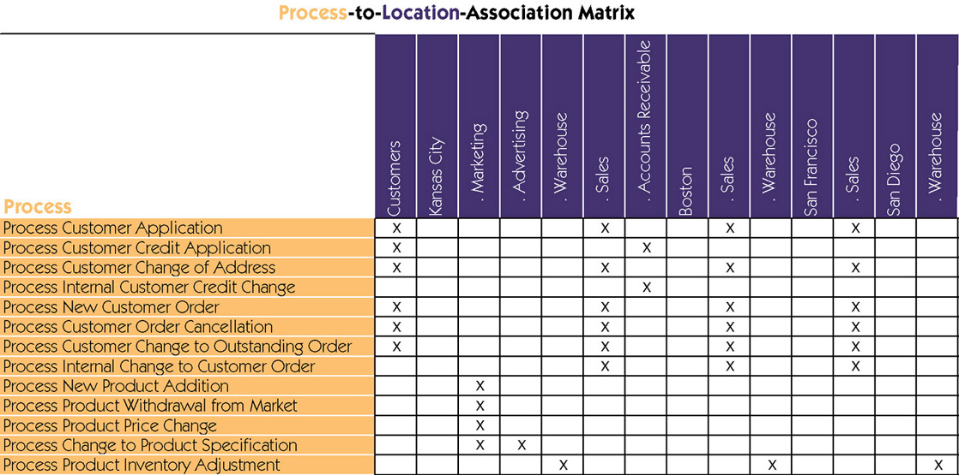
Process Distribution
9-<number>

